Slide 1
Chapter 6 – Physical and Environmental Security
Brian E. Brzezicki

Slide 2
Physical and Environmental Security
Physical security is extremely important. There is no point in technical and administrative security controls if someone can simply bypass them from physically accessing systems.
Physical security is harder today as systems are more distributed and complex.
Not just about protecting data, but more importantly PEOPLE! (remember safety is always issues #1*)
Often physical security is an afterthought when building new facilities. ☹
Lawsuits against companies CAN be filed if a company does not take adequate physical security measures.

Slide 3
Some examples of physical problems
Banks with bushes to close or to high near an ATM. Which allows criminals to hide or blocks view of crimes
Portion of an underground garage has improper lighting
Convenience store has too many signs which robbers target because the view is obstructed from the outside.

Slide 4
Threats to physical security
Natural hazards (floods, tornadoes, fires, temperatures)
Supply system threats (power outage, water, gas, WAN connection etc)
Manmade threats (unauthorized access, explosives, damage by disgruntled people, accidents, theft)
Politically motivated threats (strikes, riots, civil disobedience)

Slide 5
Physical security fundamentals
Life safety goals* should always be #1 priority
Like in technical security, defense should be layered which means that different physical controls should work together to accomplish the goal of security.
Physical security can address all of the CIA fundamental principals*.

Slide 6
Planning Process
Threats should be classified as internal or external.
Risk analysis should be taken on a physical aspect.
Assets should be identified,
threats should be identified (probabilities calculated)
countermeasures put in place that are COST EFFECTIVE and appropriate to the level of security needed.
Physical security will ultimately be a combination of people, processes, procedures and equipment to protect resources.
(more)

Slide 7
Planning Process
The planning and security program should include the following goals.
Deterrence – fences, guards, signs
Reducing/Avoiding damage by Delaying attackers – slow down the attackers (locks, guards, barriers)
Detection – motion sensors, smoke detectors
Incident assessment – response of guards, and determination of damage level
Response procedures – fire suppression, law enforcement notification etc

Slide 8
Planning process
Idea is to avoid having a physical security violation in the first place!
If you cannot stop a violation then countermeasures should mitigate damage problems.
This can be best accomplished by layering.
If a crime happens you must be able to detect it, and response should be implemented.
Remember this is the same process that we cover in Rink Analysis! All the same processes and concepts apply.

Slide 9
Target Hardening ()
Focuses on denying access through physical and artificial barriers. (alarms, locks, fences). Target hardening can lead to restrictions on the use, enjoyment and aesthetics of an environment.

Slide 10
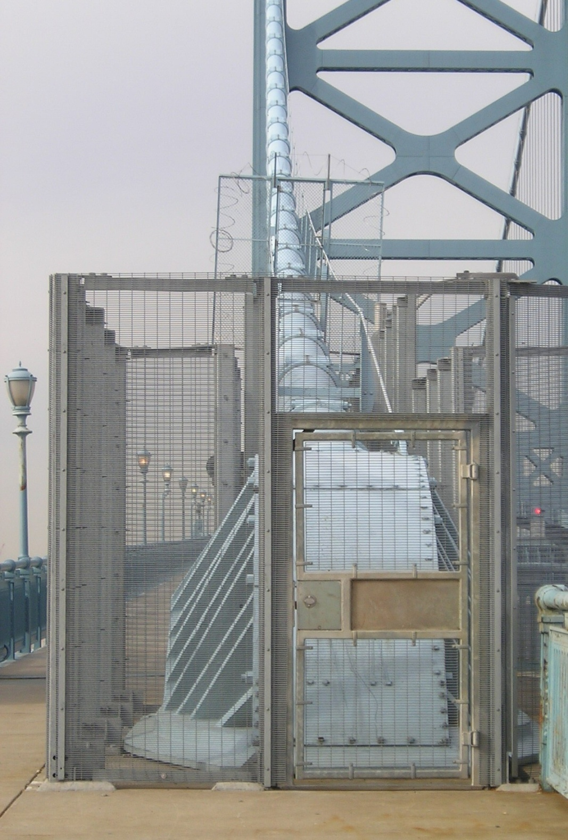
Target Hardening

Slide 11
CPTED
Crime Prevention Through Environmental Design – The idea is that proper design of a physical environment can reduce crime by directly affecting human behavior.*
CPTED provides guidance in loss and crime prevention through properly facility construction and environmental components and procedures.

Slide 12
CPTED
CPTED concepts have been used since the 1960s and have advanced as environments and crime has advanced.
CPTED looks at the components that make up the relationship between humans and their environment and tries to influence behavior by creating a environment that naturally discourages crime.
CPTED is not just used for corporate security but also for building neighborhoods etc.
(some examples CPTED guidelines are next)

Slide 13
CPTED guidelines
Examples
Hedges and planters should not be more than 2.5 feet tall.
Data center should be at the center of a facility.
Street furniture should encourage people to site and watch what is going around them.
Landscaping should not provide places to hide.
Put CCTV camera in plain view so criminals are aware they are being watched and recorded.
Be able to determined what type of physical countermeasure are influenced by CPTED

Slide 14
CPTED
CPTED provides three main strategies to bring together physical environment and social behavior to increase overall protection:
We will talk about these strategies on the upcoming slides.
Natural Access Control*
Natural Surveillance*
Territorial reinforcement*

Slide 15
CPTED (Natural Access Control)
Natural Access Control – tries to controls flow of people entering and leaving a space by the placement of doors, fences, lighting and landscaping.
Clear lines of sight and transparency are used to discouraged potential offenders.
Natural barriers can be used to create physical security zones
Methods are natural or organic, not target hardening

Slide 16
CPTED (Natural Surveillance)
Natural Surveillance attempts to discourage criminals by providing many ways for others to observe potential criminal behavior.
Examples:
Benches
Parks and other public areas

Slide 17
CPTED (Territorial Reinforcement)
Creating a space that emphasizes a organizations sphere of influence* so employees feel ownership of that space. The idea is that they will “protect” the environment (report suspicious activities, never directly intervene). It can also make criminals feel vulnerable or feel that they do not belong there.
Some examples are listed on the next page

Slide 18
CPTED (Territorial Reinforcement)
Decorated Walls
Fences
Landscaping
Lights
Flags
Company signs
Decorative sidewalks
Company “activities” (i.e.. Barbeques)

Slide 19
Good approach to Physical Security
A good approach is to design generically using CPTED first and then apply target hardening concepts where appropriate.

Slide 20
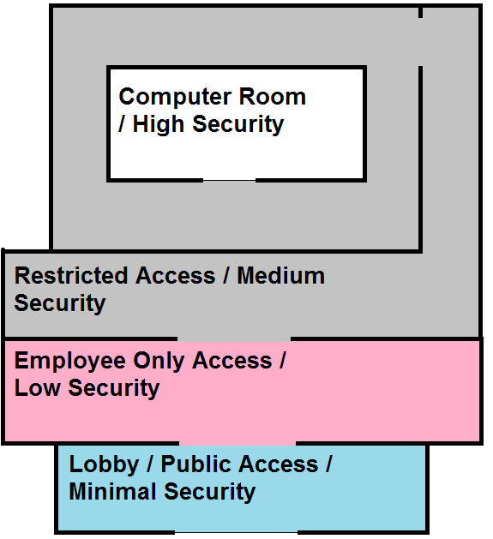
Security Zones
Zones are used to physically separate areas into different security areas.
Each inner level becomes more restricted and more secure
Stronger Access Control and Monitoring at the entry point to each zone

Slide 21
Designing a Physical Security Program
When designing a physical security program you must consider the following
HVAC systems
Construction materials
Power distribution systems
Communications lines
Hazardous materials
Proximity to airports, highways, roads
Proximity to emergency service
etc

Slide 22
Facilities
When building a new facility there are several considerations
Visibility
Surrounding area and external entities
Crime rate
Proximity to police, medical and fire stations
Accessibility
Roads/access
Traffic
Proximity to airports etc.
Natural disasters
Probability of floods, hurricanes
Hazardous terrain (mudslides, falling rocks (really?!?), excessive snow or rain)

Slide 23
Construction
Different considerations need to be considered when building a facility depending on what the facility is trying to protect and. For example (if documents are stored, fire-resistant materials should be used)
(read the bullet points on 418/419) you should memorize these.

Slide 24
Entry Points
Entry points into a building or control zone must be secured.
including windows
Including ventilation ducts etc.
All components of a door should be equally as strong (hinges, door construction) as security is only as good as the weakest link

Slide 25
Doors
Fire codes dictate that exit bars be on doors.
Doors can be hollow core or solid core, hollow core doors should only be user internally*.
Doors with automatic locks can be
Fail safe* - what does this mean?
Fail secure* - what does this mean?

Slide 26
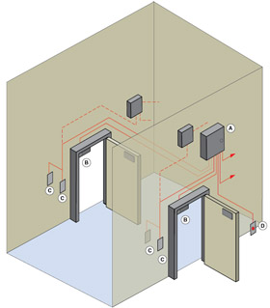
Man Trap*

Slide 27
Windows
There are different type of windows that you should now about*
Standard glass – residential home/easily broken
Tempered glass – glass that is heated and then suddenly cooled. 5-7x stronger than regular glass
Acrylic glass (plexiglass/lexan) – stronger than regular glass, but gives off toxic fumes if burnt.
(more)

Slide 28
Windows
Glass with embedded wires – avoids glass shattering
Laminated glass – two sheet of glass with a plastic film in between. Harder to break.
Glass can be treated with films to tint for security.

Slide 29
Computer Room
Computer rooms are where important servers and network equipment is stored.
Equipment should be placed in locked racks*.
Computer rooms should be near the center of the building, and should be above ground, but not too high that it would be difficult to access by emergency crews*
Strict access control should be enabled*.
They should only have 1 access door, though they might have to have multiple fire doors*
(more)

Slide 30
Computer Room
Computer Room should have positive air pressure*
There should be an easy to access emergency off switch*
Portable fire extinguishers
Smoke/fire sensors should be under raised floors*.
Water sensors should be under raised floors and on ceilings*
(more)

Slide 31
Computer Room
Temperature and Humidity levels should be properly maintained*
Humidity too low, static electricity*
Humidity too high, corrosion of metal parts*
CR should be on separate electrical systems than the rest of the building
Should have redundant power systems and UPS

Slide 32
Protecting Assets (429)
Organizations must protect from theft. Theft of laptops is a big deal especially if private information is on the laptop (Confidentiality,Legal).
You should understand best practices in regards to physically protecting things from being stolen.
Inventory all laptops including serial number
Use disk encryption on laptops
Do not check luggage when flying
Never leave a laptop unattended
Install tracking software on laptops (low jack type software)
Password protect the BIOS (See next slide)
(more)

Slide 33
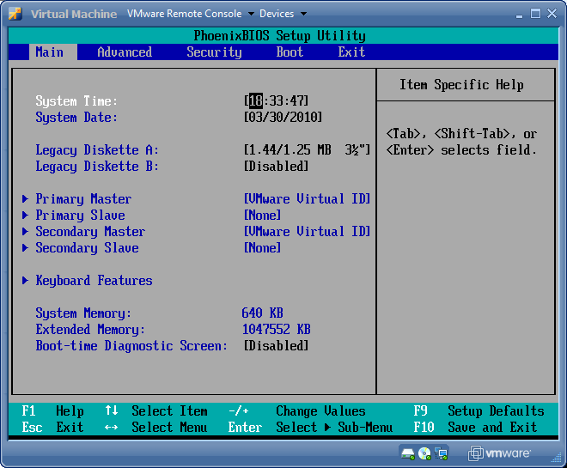
BIOS

Slide 34
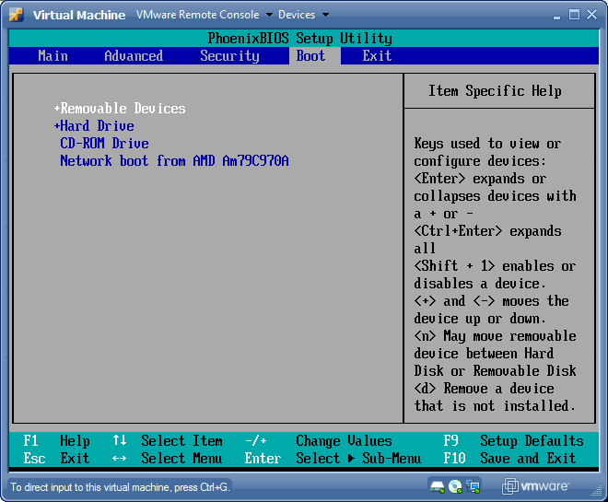
BIOS

Slide 35
Protecting Assets
You should also be aware of the types of safes that exist
Wall safe
Floor safe
Chest (stand alone)
Depositories (safes with slots)
Vaults (walk in safes)

Slide 36
Internal Support Systems
Power is critically important for data processing we will talk about some different power issues and concerns to be aware off.

Slide 37
Electrical Power Issues
Electromagnetic Interference – electromagnetic that can create noise. (motors can generate fields)
Radio Frequency Interference – fluorescent lights
(see next slide for visualization)

Slide 38
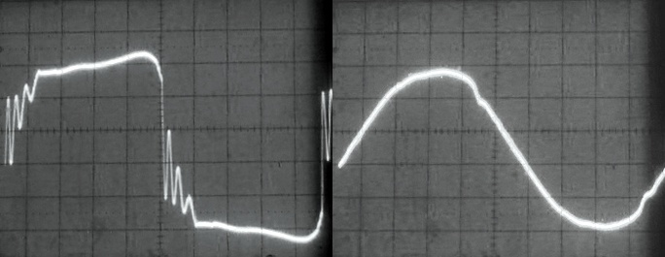
Electric power issues
Power interference that stops you from getting “clean power” this is called line noise.

Slide 39
Electrical Power Issues
There are times where the voltage delivered falls outside normal thresholds
Excess
Spike – momentary high voltage*
Surge – prolonged*
Shortage
Sag/dip – momentary low voltage*
Brownout – prolonged low voltage*
Loss
Fault – momentary outage*
Black out*

Slide 40
Electrical power issues
In rush current – when a bunch of things are turned on, power demands are usually higher, and may stress power supplies, causing a sag/dip or a trip breakers.
Try to have computer equipment on different electrical supplies than other office equipment
DO NOT install microwaves or vacuums on computer power circuits.

Slide 41
Power
UPS (need visualization)
Online
Standby
Power line conditioners
Backups generators
Know what each power countermeasure is used for or when they are appropriate.

Slide 42
Power best practices
Use surge protectors on desktops
Do not daisy change surge protectors (see next slide)
Employ power monitor to detect current and voltage changes
Use regulators or line conditioners in computer rooms
Use UPS systems in computer rooms
If possible shield power cables in conduit
Do not run power over or under fluorescent lights

Slide 43
Daisy Chained Power Strips

Slide 44
Environmental Issues
Improper environments can cause damage to equipment or services
Water and Gas
Make sure there are shutoff valves and that they have positive drains (flow out instead of in, why?)
Humidity*
Humidity must not be too high or too low
Low – static
High – rust/corrosion
Hygrometer measures humidity
(more)

Slide 45
Environmental Issues
Static electricity – besides ensuring proper humidity
use anti-static flooring in data processing areas
Don’t use carpeting in data centers
Wear anti-static bands when working inside computers.

Slide 46
Environmental Issues
Temperature – Should not be too high or equipment failure will occur. Room temps should be in the 60s ideally.
Ventilation
should be closed loop (re-circulating)
Positive pressure
If a fire is detected HVAC should be immediately turned off.

Slide 47
Fire prevention
It’s obvious that you should have fire prevention, detection and suppression systems. Which types you use depends on the environment.
Fire detection systems –
Smoke activated (using a photoelectrical device)
Heat activated
Rate of rise sensors
Fixed temperature sensors

Slide 48
Fire prevention systems
Detectors need to be properly placed
On and above suspended ceilings*
Below raised floors*
Enclosures and air ducts*
Uniformly spread through normal areas*

Slide 49
Fire suppression ()
A fire needs fuel, oxygen and high temperatures to burn*. There are many different ways to stop combustion
fuel – soda acid (remove fuel)*
oxygen – carbon dioxide (removes oxygen)*
Temperature – water (reduces temperature)*
Chemical combustion – gas (interferes with the chemical reactions)*

Slide 50
Fire Suppression
Different fire suppression types based on class of fire
A
B
C
D
(we’ll talk about each of these)

Slide 51
Fire Suppression
A – Common Combustibles*
Use for: Wood, paper, laminates
Uses water or foam as suppression agent
B – Liquid*
Use for: gas or oil fires
Use: Gas (CO2), foam, dry powders

Slide 52
Fire Suppression
C – Electrical*
Use on: electrical equipment and wires
Uses: Gas, CO2, dry powder
D – Combustible metals
Use on: combustible metals (sodium, potassium)
Uses: dry powder

Slide 53
Fire Suppression (Gases)
Before any type of dangerous gas (CO2) is released there should be some type of warning emitted. (CO2 will suffocate people)
Halon is a type of gas that used to be commonly used, it is no longer used do to CFCs. It was banned by the “Montreal protocol”* in 1987*. effective replacement is FM-200 or others on top of pg 444*

Slide 54
Fire Suppression Note
HVAC system should be set to shutdown when an automatic suppression system activates.

Slide 55
Fire Supression Systems
Now we need to understand automatic fire suppression systems

Slide 56
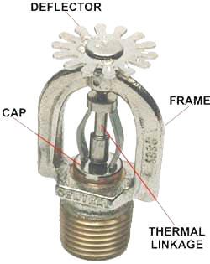
Sprinkler Heads
The thermal linkage is often a small glass tube with colored liquid that is designed to shatter at a fixed temperature.
The fire will heat the Thermal Linkage to its break point, at which point the water in the pipe will flow freely through the opening at a high pressure. The pressure of the water causes it to spread in a wide area when it hits the deflector

Slide 57
Automatic fire suppression
Sprinklers –
Wet Pipe – high pressure water in pipe directly above sprinkler heads
Deluge – Type of wet pipe with a high volume of water dispersal, not used for data centers.

Slide 58
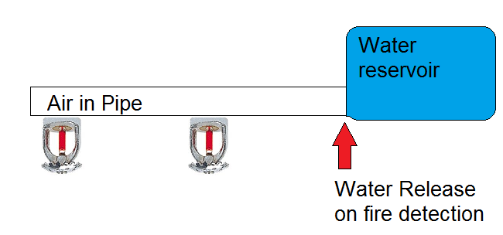
Automatic fire suppression
Dry Pipe – Air in pipe overhead, water in reservoir. Used where freezing temperatures may occur*.

Slide 59
Automatic fire suppression
Pre action – like dry pipe but water is released / primed by an independent sensor

Slide 60
Fire random tidbit
Plenum – The crawlspace above a ceiling.
Know the term
Cables run in the Plenum area MUST be plenum cable which gives off less toxic fumes when burning.

Slide 61
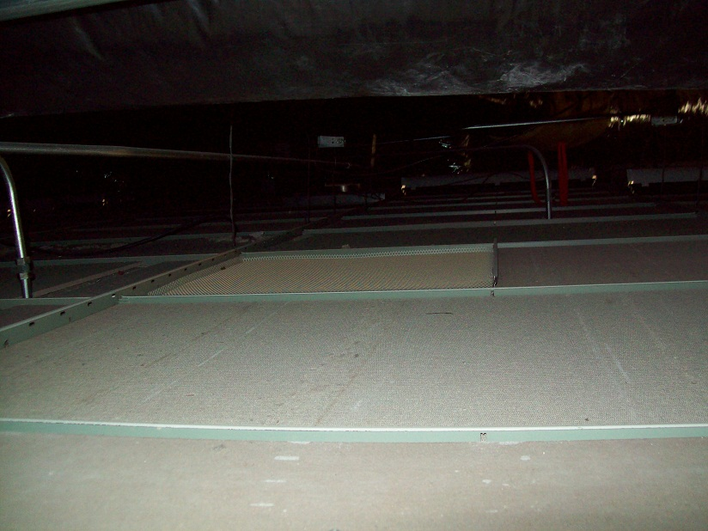
Plenum

Slide 62
Perimeter security
Perimeter security is concerned with protecting the outside of your facility. Ensuring that there is no un-authorized physical access. Perimeter security can implement multiple controls to keep the facility secure
Some controls that are used that we will look at are
Locks
Personnel access controls
Fencing
Lighting
Bollards
Surveillance devices
Intrusion detection systems
Guard dogs

Slide 63
Perimeter Security
Locks – purpose of locks is to DELAY* intruders, until they can be detected and apprehended. There are multiple types of locks that we will talk about
Mechanical
Combination locks
Cipher locks

Slide 64
Locks
Mechanical – use a physical key (Warded lock or tumbler)
Warded lock – basic padlock, cheap (image)
Tumbler lock – more pieces that a warded lock, key fits into a cylinder which moved the metal pieces such that the bolt can slide into the locked and unlocked position.
Pin tumbler – uses pins
Wafer – uses wafer (not very secure)

Slide 65
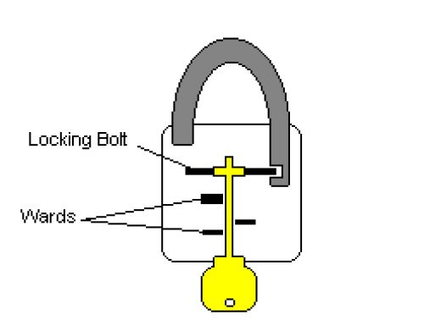
Warded Lock

Slide 66
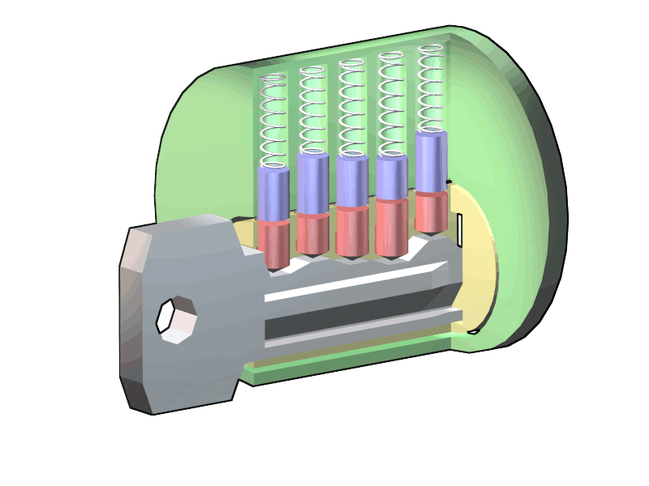
Tumbler Lock

Slide 67
Locks types (453)
There are different lock grades*
Grade 1 – commercial
Grade 2 – heavy duty residential, light commercial
Grade 3 – residential throw away locks
There are also 3 cylinder categories
Low – no pick or drill resistance provided
Medium – a little pick resistance
High – higher degree of pick resistance

Slide 68
Attacks against key type locks
Tension wrench – shaped like an L and is used to apply tension to the cylinder, then use a pick to manipulate the individual pins*.
Pick – used in conjunction with a tension wrench to manipulate the pins into place so you can turn the cylinder*
Visualization next slide

Slide 69
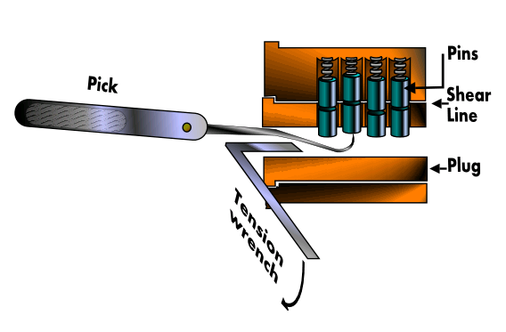
Lock Picking

Slide 70
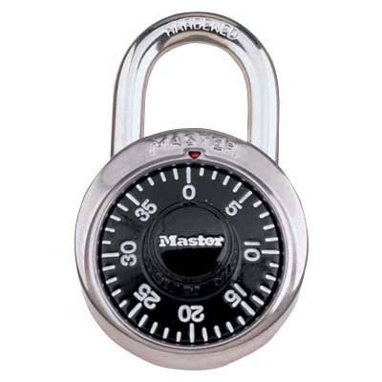
Locks
Combination locks – rather than use a key, turn

Slide 71
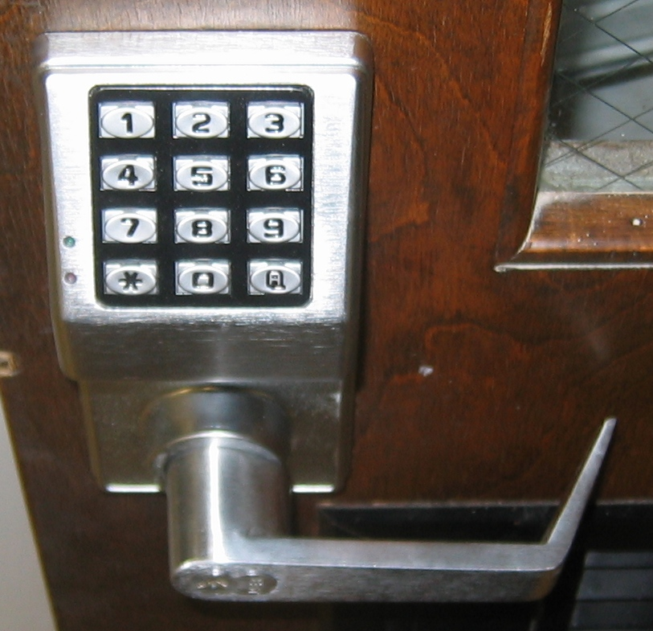
Cipher Lock*

Slide 72
Cipher Lock
Cipher locks – electronic locks*
Advantages*:
Combination can be changed
Combination can be different for different people
Can work during different times of day
Can have override codes
Subtype of Override Code is an emergency code*

Slide 73
Device Locks
Device Locks - Computer equipment sometimes must be locked (laptops, or physically blocking out slots). Some type of device locks are

Slide 74
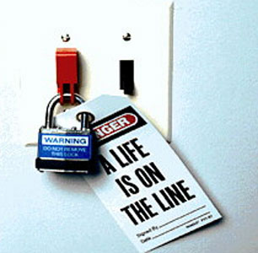
Switch Lock

Slide 75
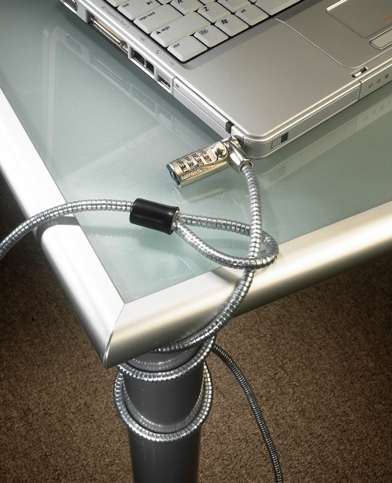
Port / Laptop Lock
Slot locks physically lock into the expansion slots to physically secure systems.

Slide 76
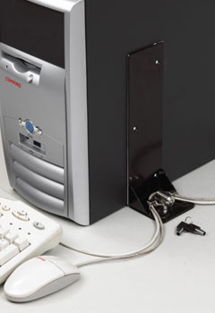
Device Locks
Port controls – block access to floppy or USB ports
Cable traps – lock down cables from being unplugged and removed.

Slide 77
Personnel access controls
There are different technologies to grant access to a building.
User activated – a user does something (swipe cards, biometrics)
Proximity devices/transponders – a system recognizes the presence of an object. (Electronic access control tokens) is a generic term for proximity authentication systems)

Slide 78
Fencing
Can deter and delay intruders
Fences 3-4 feet high only deter casual trespassers*
Fences 6-7 feet high are considered too high to climb easily*
Fences 8 feet high should are considered serious.*
(more)

Slide 79
Fencing
Memorize the gauges and mesh size chart on pg 457
Fencing best practices
Fences should be a first line of defense.*
Critical areas should have fences of 8 feet*.

Slide 80
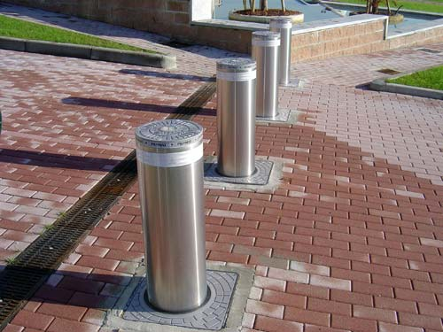
Bollards*

Slide 81
Bollards
Bollards are small concrete pillars, sometimes containing lights or flowers.
They are used to stop people from driving through a wall, often put between a building and parking lot.
They can be arranged to form a natural path for walking.*

Slide 82
Lighting
Lighting is obviously important in perimeter security. It decreases the probability of criminal activity*.
Each light should cover it’s own zone and there should not be gaps in the coverage.*
Coverage in fact should overlap.*
Lighting should be directed AWAY from the security guards etc.*

Slide 83
Surveillance
Surveillance systems are a detective control. Generally these are CCTV systems.
CCTV systems consist of
Cameras
Transmitters
Receivers
Recording systems

Slide 84
Surveillance
Most camera are charged coupled devices that takes light from a lens and turns it into an electrical signal.
There are two types of lenses in CCTV camera
Fixed focal length
Variable focus length (zoom lens)
We will define focal length next slide
(more)

Slide 85
Focal Length
Focal Length = The distance from the surface of a lens or mirror to its focal point.
short focal length = wide angle*
long focal length = narrow, but higher magnification*

Slide 86
Depth of Field
Depth of field = Depth of field is the range of distance within the subject that is acceptably sharp
large depth of field = everything is generally sharp
short depth of field = something is specifically "focused" on where everything else is fuzzy.
(see next slide)

Slide 87
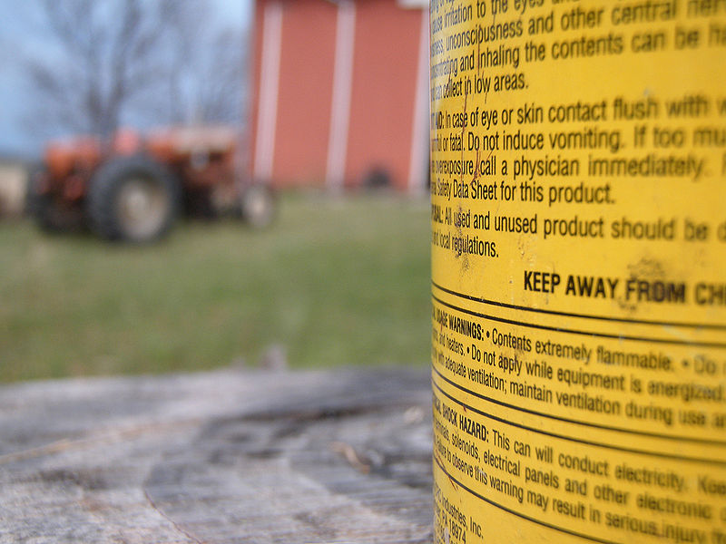
Depth of Field

Slide 88
Depth of Field
depth of field increases as the lens opening DECREASES*
depth of field increases as the focal length DECREASES*
Best combination to cover a large area is a wide angle lens with a small lens opening*
(short focal length and large depth of field)

Slide 89
Surveillance
Focal Length - If you don’t have a CCTV camera that can change, you must pick an appropriate focal length for your application.
Generally you should have cameras with auto-irises that can adjust to how bright the outside conditions are
Zoom lenses allow you to change
PTZ cameras (pan, tilt, zoon)

Slide 90
Intrusion Detection Systems
IDS (physical IDS, NOT network IDS) – help detect the physical presence of an intruder.
Can be multiple types.

Slide 91
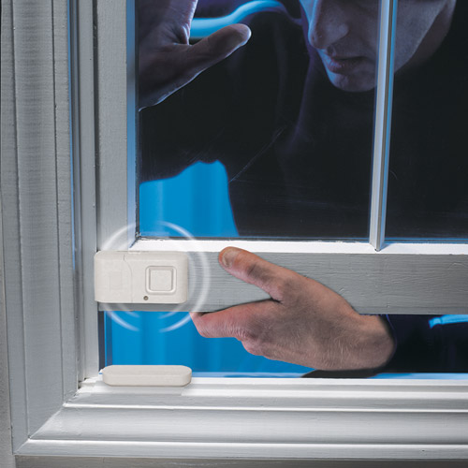
Electromechanical IDS
Electromechanical – traditional types, determine a opening of a window by a break in connectivity.
Vibration sensors are also electromechanical
Pressure pads are also electromechanical

Slide 92
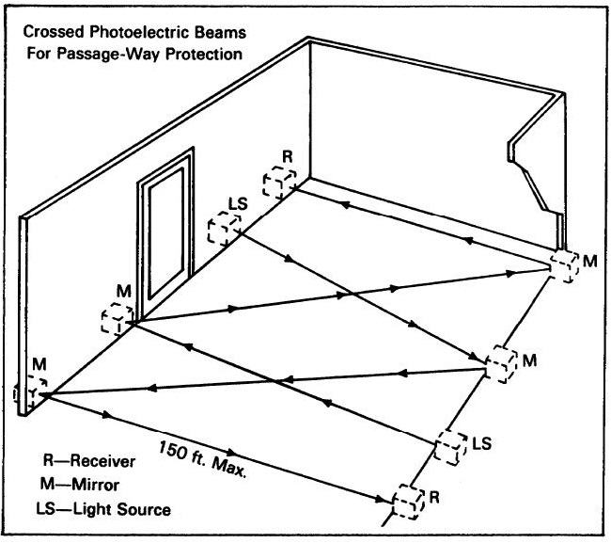
Photoelectric IDS
Photoelectric – uses light beams to detect when something crosses the beam.

Slide 93
IDS
Acoustical Detection – uses sound (like sonar)
Proximity detector/capacitance detectors – emits a measurable magnetic field. If field is disrupted it sets off the alarm. (usually this field is a very small area, as magnetic fields disperse quickly as the area increases)

Slide 94
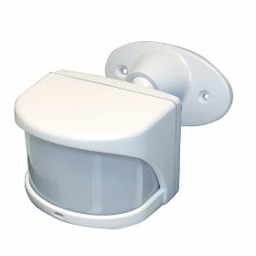
Passive Infrared IDS
Passive Infrared (PIR) – monitors heat signatures in a room. (a lot of home automatic light systems are of this type)

Slide 95
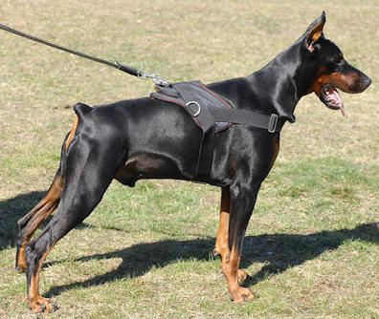
Patrols and Guards
Guards – provide a dynamic response, guards can make decisions based on the situation, which most other IDS cannot.*
Dogs – highly useful in detecting intruders and discouraging attacks.*

Slide 96
Chapter 6 - Review
Q. What is a Class A fire?
Q. What is a Class B fire?
Q.What is a Class C fire?
Q. What is the Montreal Protocol About?
Q. What is a replacement for Halon?

Slide 97
Chapter 6 - Review
Q. What is a security Zone?
Q. What is the idea of CPTED?
What are the 3 main concepts
Natural ________ ________
Natural __________________
Territorial ________________
Q. What is “target hardening?”
Q. What is the ultimate goal/concern with physical security?

Slide 98
Chapter 6 - Review
Q. What are the 5 goals of physical security
D______
D______
D______
Incident assessment
Response procedures
Q. Where should a computer room be located in a building

Slide 99
Chapter 6 – Review
Q. What type of Interference does Fluorescent lights cause?
Q. In a computer room, there should be ______ air pressure and _______ water pressure.
Q. In a computer room there should not be too much or too little humidity, too little humidity causes __________. Too much humidity causes __________
Q. What type of water based sprinkler system is best used in a computer room (wet pipe, dry pipe, pre-action?)

Slide 100
Chapter 6 - Review
Q. In a fire soda acid removes (heat, fuel, or stop chemical combustion?)
Q. In a fire water removes (heat, fuel, or stop chemical combustion?)
Q. In a fire, gas is used to remove (heat, fuel, or stop chemical combustion)

Slide 101
Chapter 6 - Review
Q. Lighting should point (away from OR towards guards)
Q. For critical security areas fences should be at least 6,7 or 8 feet high?
Q. If choosing a CCTV camera for outdoor use should it have a manual iris or an auto-iris?
Q. What type of IDS system gives off an electromagnetic field and detects as that field is disturbed
Q. What type of IDS system detects heat emanated from a human body?

